Slide 1
Wallpaper design in break time

Slide 2



Slide 3



Slide 6



Slide 8


Slide 9
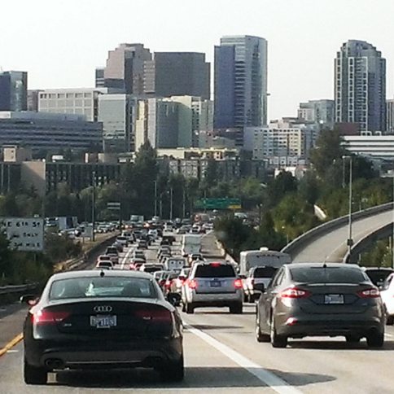
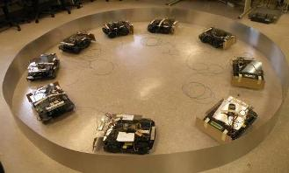




Slide 10


Slide 11




Slide 12





Slide 13
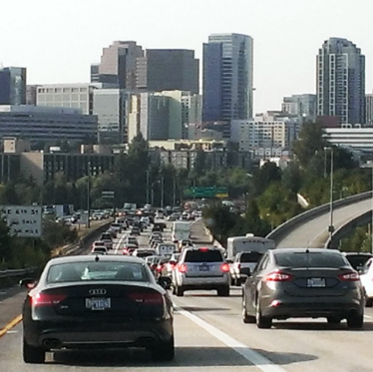

Slide 14
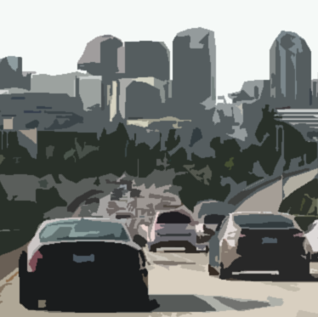



Slide 15


Slide 18


